Slide 1

Adobe Analytics Challenge
Sachit Saraf, Prasham Parikh, Sava Kholin
Kodaline

Slide 2
Overview
We take web purchases data in our analysis as it contributes to the majority of revenue. (75%)
We identify drivers of repeat purchases on Disney website.
We use derived insights to help us customize marketing activities and drive RPR.
We contrast purchase flow from mobile and desktop device to increase conversion for desktop device.
Data Period: Last Year
Kodaline

Slide 3
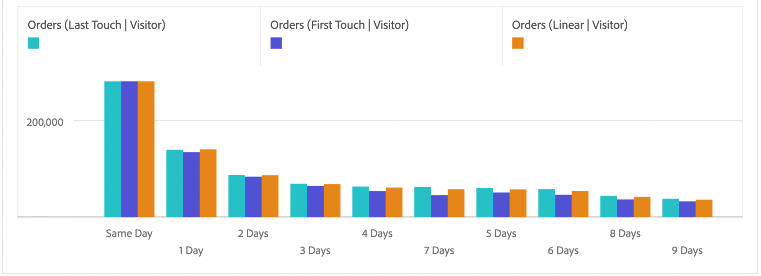
Follow-up emails or other impressions on the same day/following day of purchase would drive RPR.
Customers are significantly more likely to put a recurring order the same or the next day than on second day or later.
Kodaline

Slide 4
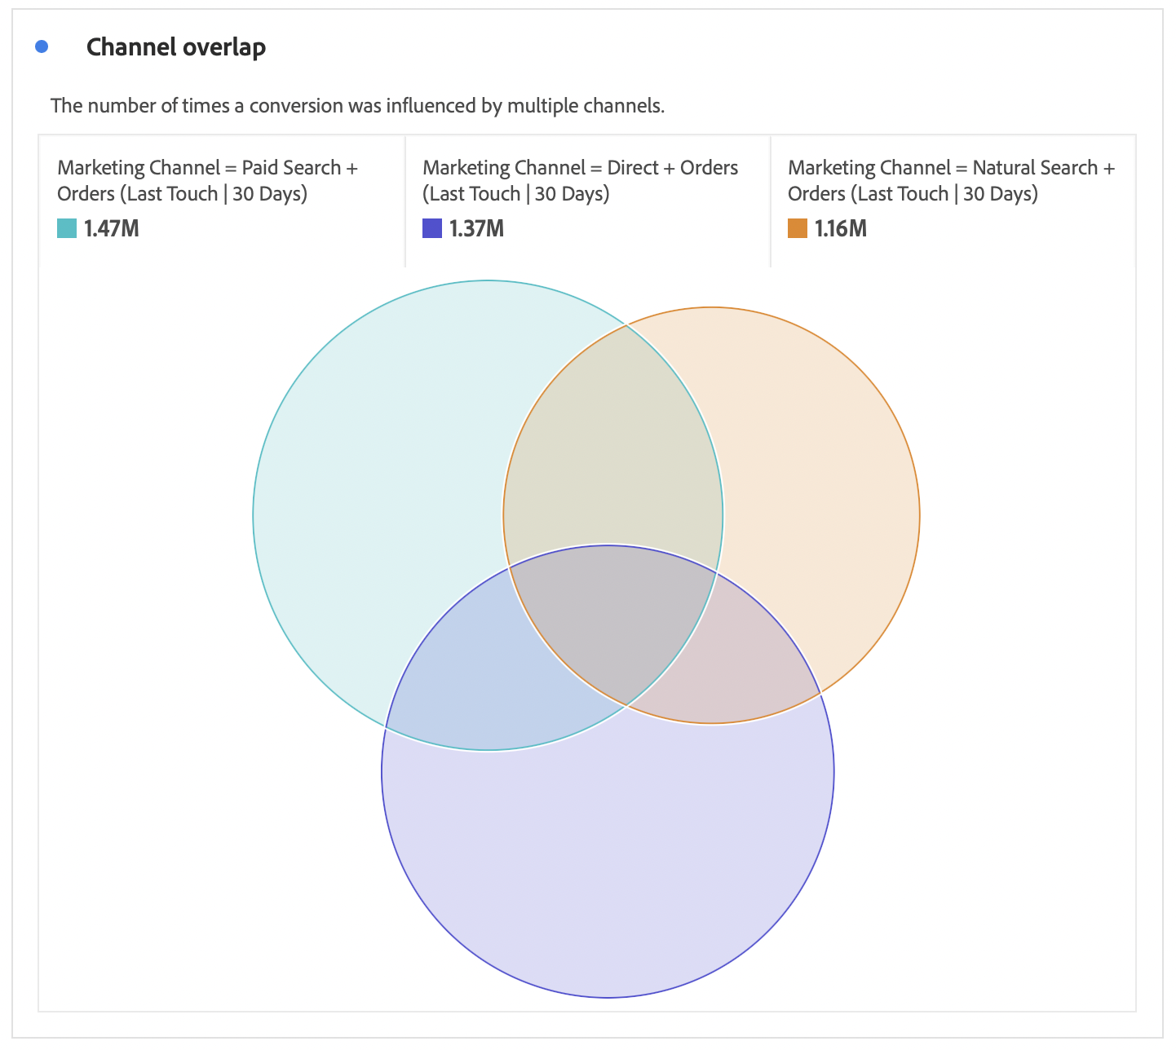
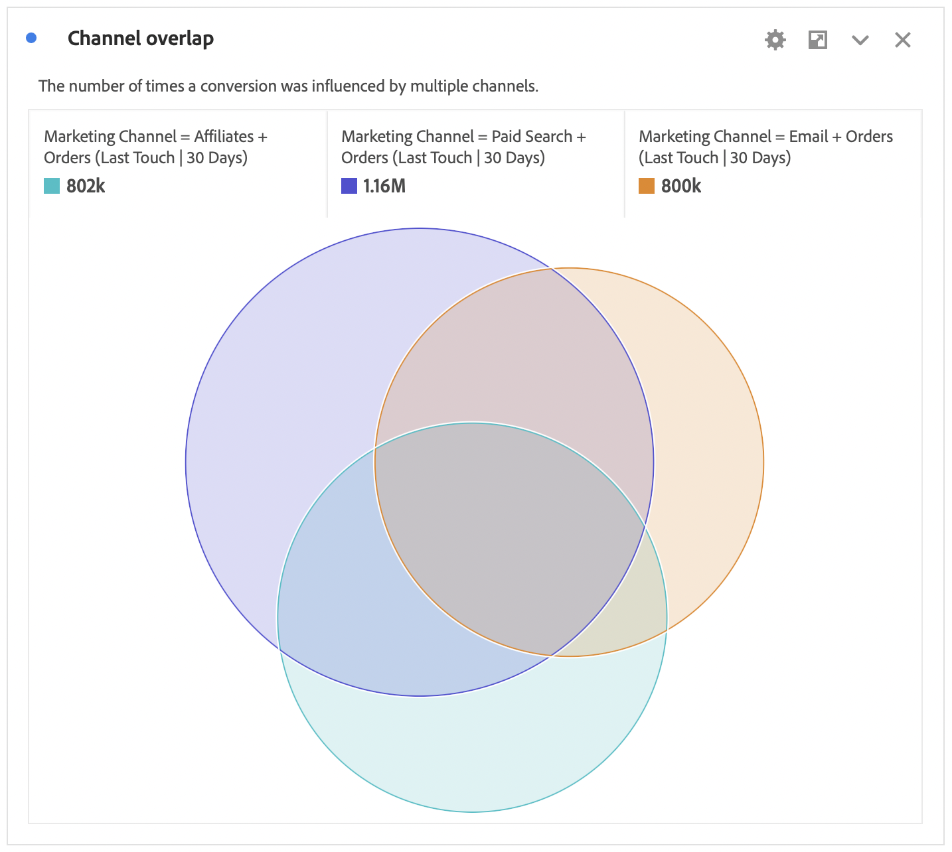
Omni-channel strategy might promote RPR.
Returning customers tend to place orders after getting impression from different marketing channels.
4.13%
14.53%
Kodaline

Slide 5
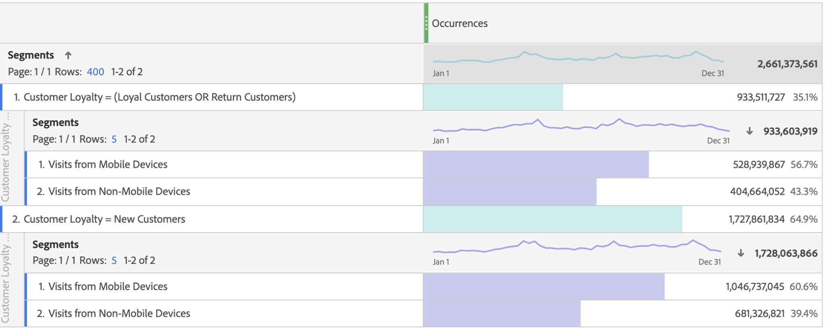
Promoting mobile platform might increase RPR.
Returning customers are more prone to use mobile device.
Kodaline

Slide 6
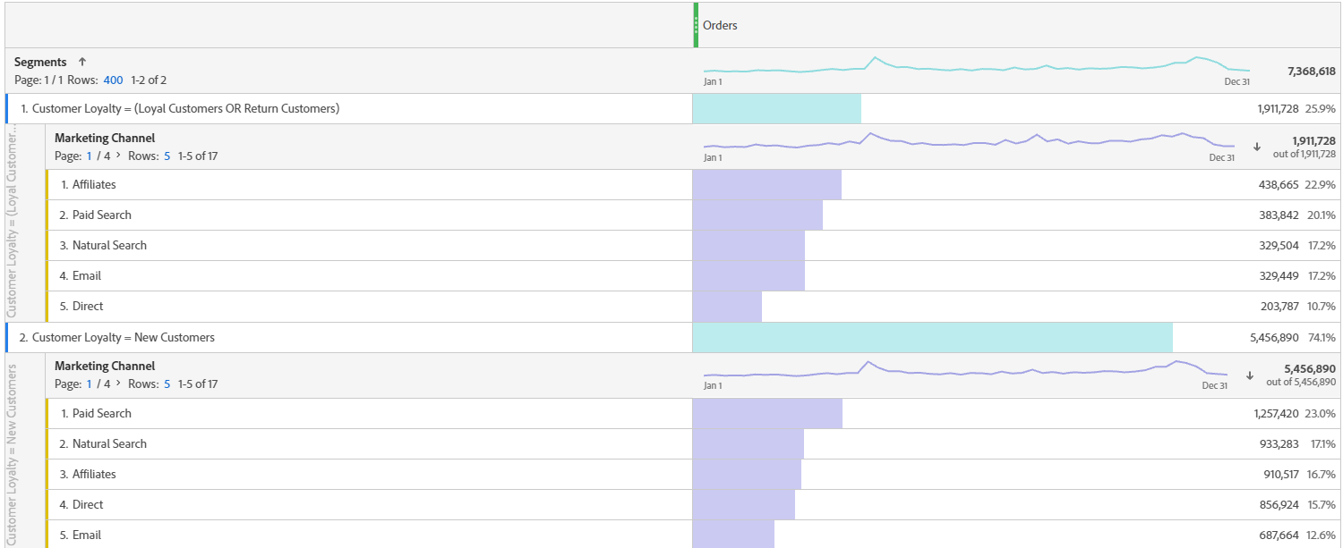
Affiliates and Email drive RPR
Affiliates and email contribute relatively 6% more to orders for repeat purchasers.
Kodaline

Slide 7
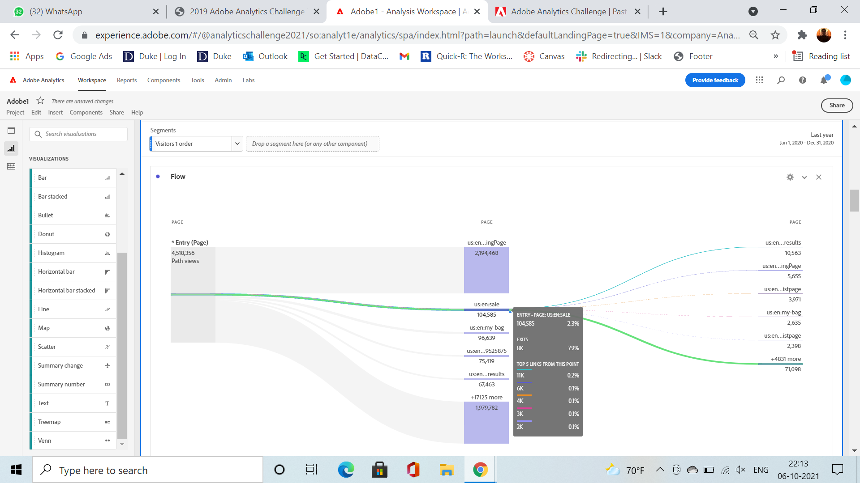
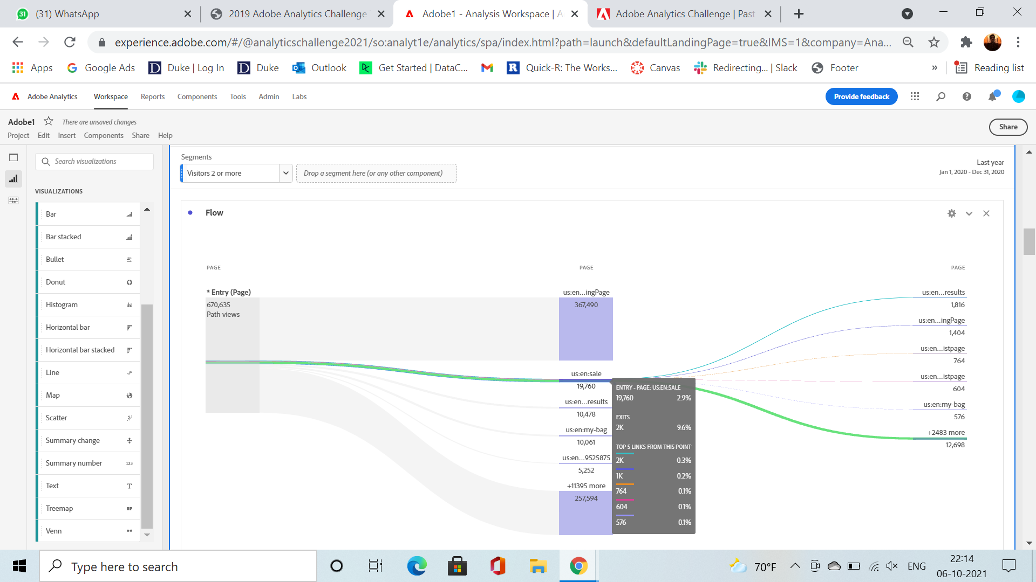
Promoting sale page as a landing page might increase RPR
Loyal customers “land” on sales page 25% more often compared to new customers before placing an order.
Kodaline

Slide 8
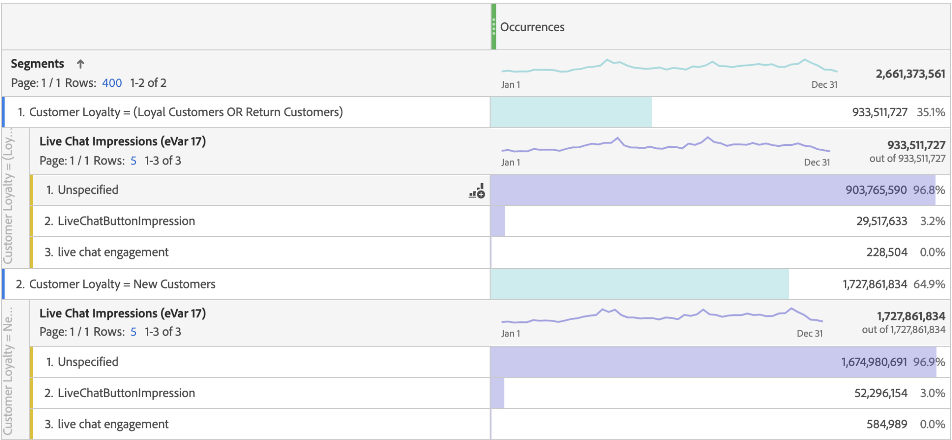
Life chat impressions promote recurring purchases.
Loyal customers get relatively 8% more live chat impressions before making a purchase.
Kodaline

Slide 9
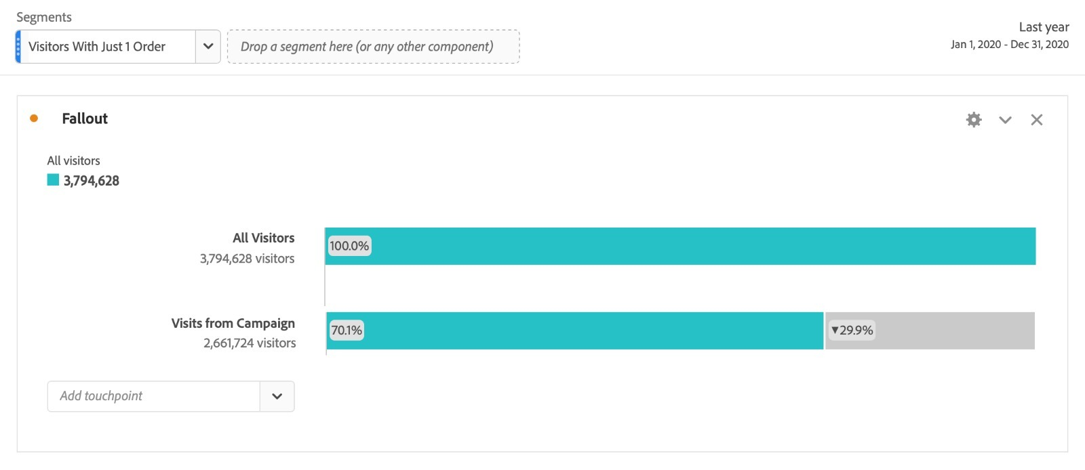
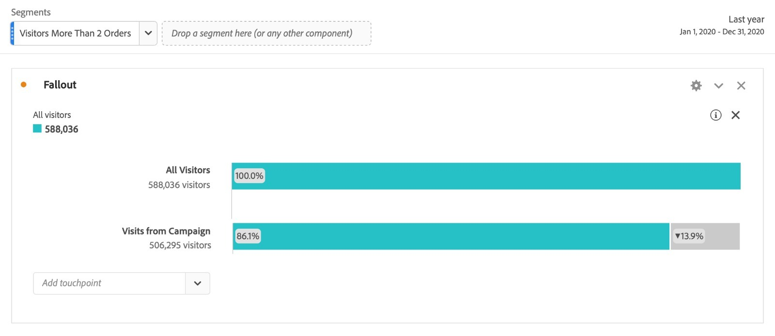
Campaigns are more effective for customers who have already placed their first order
Customers with
1 order
Customers with
>=2 orders
When users who have placed a single order are engaged in campaigns, their conversion rate improves.
Kodaline

Slide 10
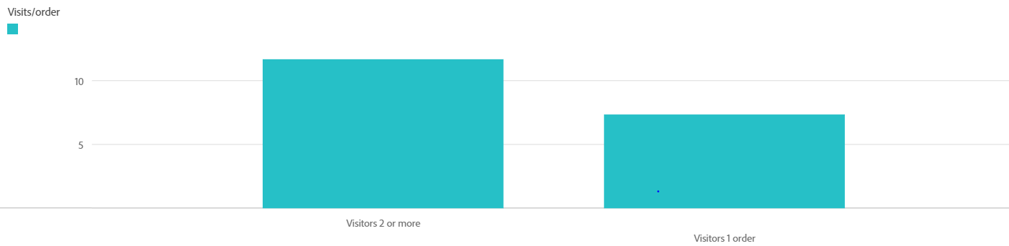
More visits, more purchases
More visits drive you to purchase more, notably the 70% difference in the visits per order between a single order purchaser and multiple order purchaser.
Kodaline

Slide 11
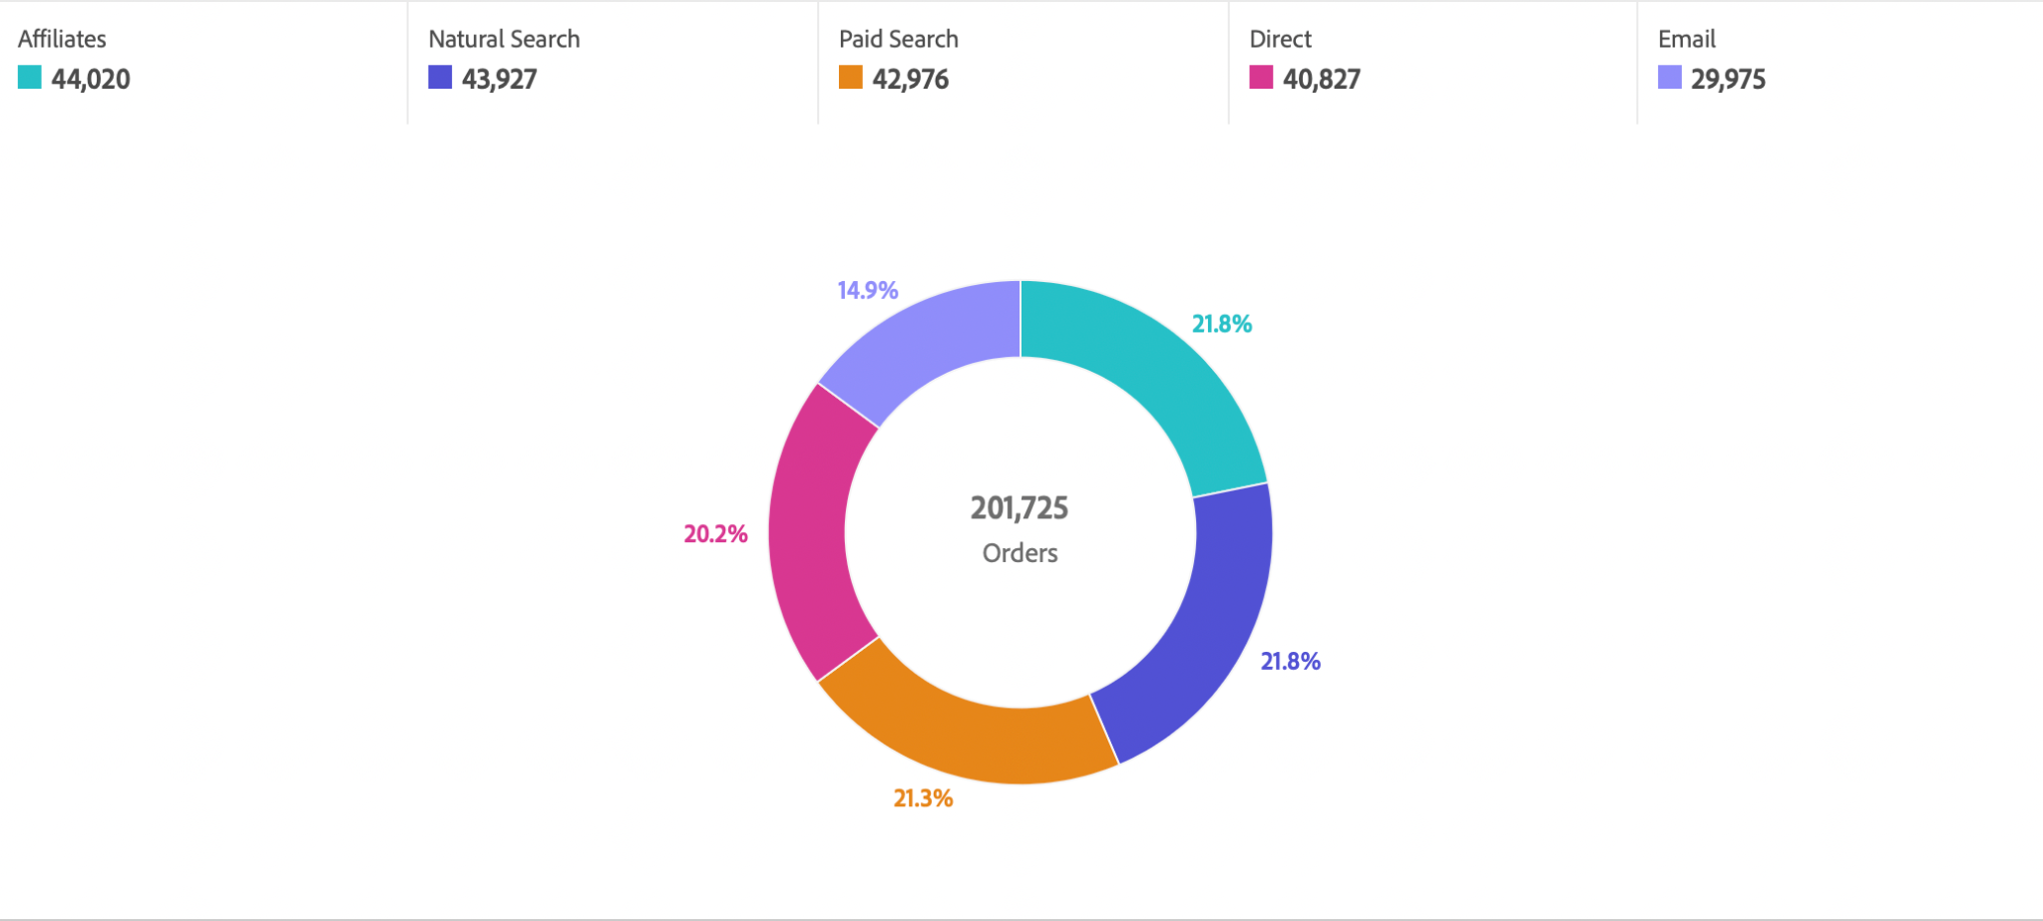
A healthy mix of marketing channels should help convert users who abandoned their cart
Affiliates, Natural Search, Paid Search, and Direct all play an almost equal role as seen below.
Kodaline

Slide 12
Moving login page to the checkout would increase conversion in Disney Web.
Visitors from non-mobile device “land” on page with significantly higher bounce rate.
Non-mobile
Mobile
41.4% Landing
30.4% Landing
Probability to “land on”
3.3% Login
3.0% “Bounce”
2.6% Sale
0.3% “Bounce”
Other
Other
* Not to scale
Kodaline

Slide 13
Summary
We identified strategies to increase RPR such as: follow-up emails, omni-channel strategy, affiliate links and other.
Other behaviour patterns such could help optimise marketing costs.
Cart abandonment issues can be addressed by using a healthy mix of marketing channels.
Moving login page to the checkout would increase conversion in Disney Web.
Kodaline

